Slide 1

Bangladesh Army University of Science and Technology
Project Presentation
Course Title: Software Development Project II
Course Code: CSE-2200
Supervised By:
Md. Toukir Ahmed
Lecturer, Department of Computer Science & Engineering.
Bangladesh Army University of Science & Technology (BAUST),
Saidpur Cantonment, Saidpur, Nilphamari.

Slide 2
Bangladesh Army University of Science and Technology
Submitted By:
Zarin Rafah Chowdhury
ID: 180201078
Batch: 8th Batch
Level: 2 Term: II
Section: ‘B’ Group: G2
Department of Computer Science & Engineering, BAUST.

Slide 3

PROJECT TITLE: “O-DOCTOR” “Every valuable life matters…” Introduction: “O-Doctor” is a hospital distribution system which holds records , presents a lucid manifestation of Hospitals and Diagnosis Center and differentiate them by the service to either Covid-19 or Non-Covid-19 patient in Bangladesh .

Slide 4
Goals of this Project:
01. Non COVID-19 Hospital & Diagnosis Center:
How many hospitals are serving there in each Division.
Where normal all diagnostic labs are located and Contact info of them.
02.
COVID-19 test labs Info:
Can easily find where the COVID-19 is diagnosed and reports are provided.
03.
COVID-19 Treatment Hospital:
Can easily find where the COVID-19 Patients are provided proper treatment and contact details.
04.
Medical Emergency Info:
Ambulence Service Info.
Blood Bank Info.

Slide 5
Equipments:
Laptop.
NetBeansIDE 8.2 .
Xampp Control Panel.

Slide 6



Project Work Management
+ Assembling
Code & Database
Data Collection JAVA Project Code Final Project.
(Database) (NetBeans) (O-DOCTOR)

Slide 7
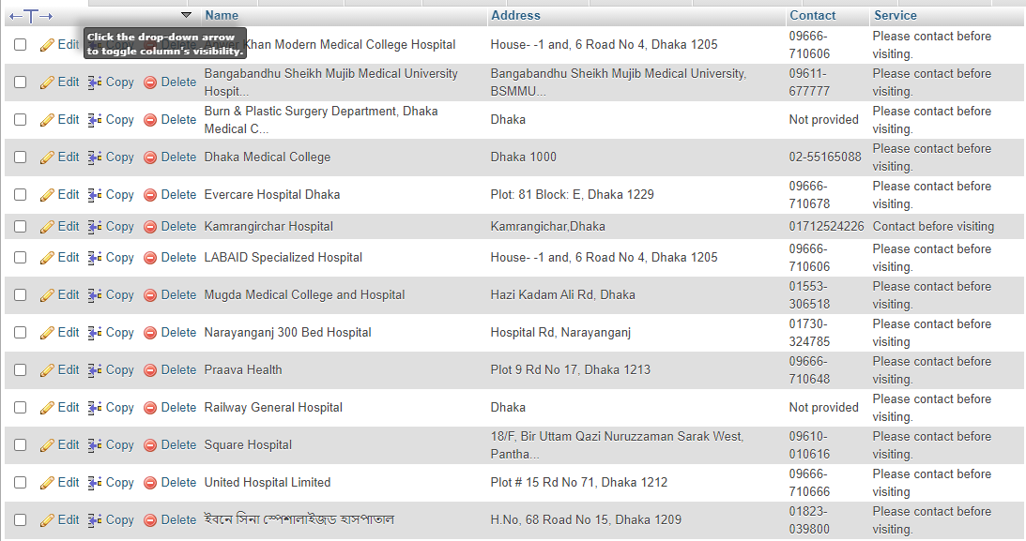
General Hospitals. (25)
General Diagnostic Center.(15)
COVID-19 Hospitals.(7)
COVID-19 Test Labs.(7)
Ambulance Services.(11)
Blood Bank Services.(8)
Data Collection & Database:
Chittagong
General Hospitals. (40)
General Diagnostic Center.(20)
COVID-19 Hospitals.(14)
COVID-19 Test Labs.(11)
Ambulance Services.(12)
Blood Bank Services.(10)
O-DOCTOR
Dhaka
General Hospitals. (16)
General Diagnostic Center.(14)
COVID-19 Hospitals.(2)
COVID-19 Test Labs.(2)
Ambulance Services.(8)
Blood Bank Services.(5)
Rangpur

Slide 8
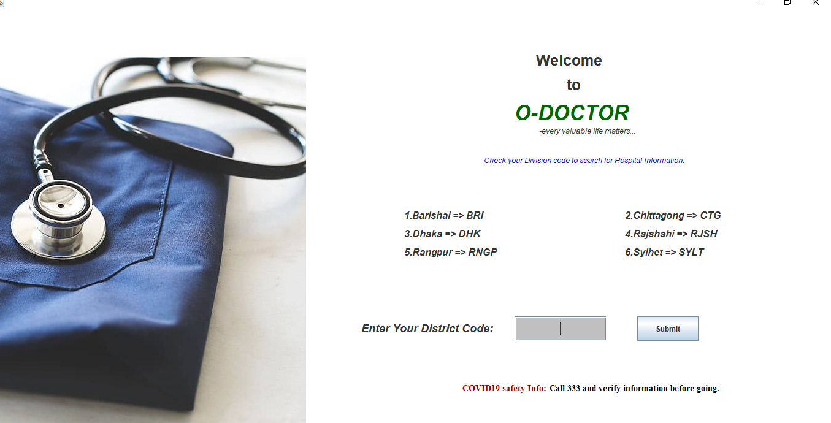
Home Page: (Main Menu)

Slide 9
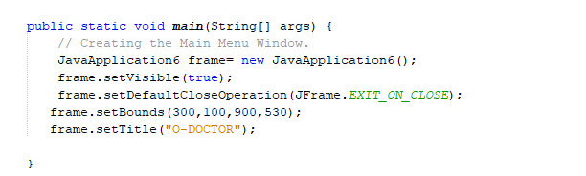
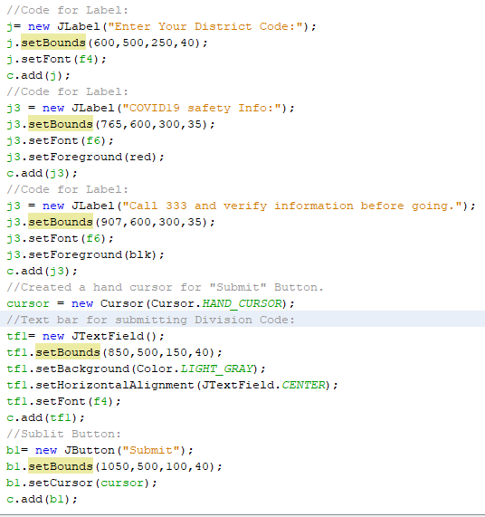
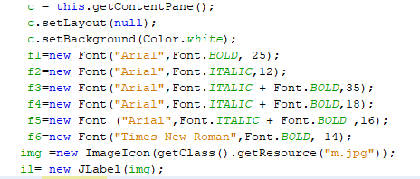
Source Code for creating Main Menu window:
Some Code Section of Main Menu
Source code for Text Bar , Submit Button & Hand Cursor:
Source code of different font application and image insertion:

Slide 10
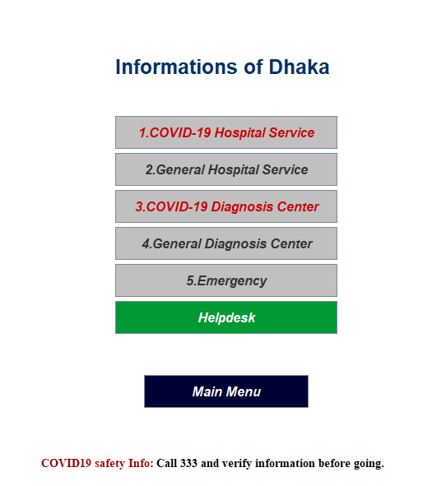
Division Info Page:
Project Output:
Every division (Dhaka , Chittagong, Rangpur) will contain a page like this.
Q
Covid-19 Treatment Hospital:
Contains all information about COVID-19 Hospitals.
A
General Hospital Service
Contains all information about General Hospitals
Covid-19 Test Lab:
Contains all information about COVID-19 Test Labs.
General Diagnosis Center
Contains all information about General Diagnostic Centers in that division.
Emergency
Contains Blood Bank & Ambulance Service Info of that division.

Slide 11
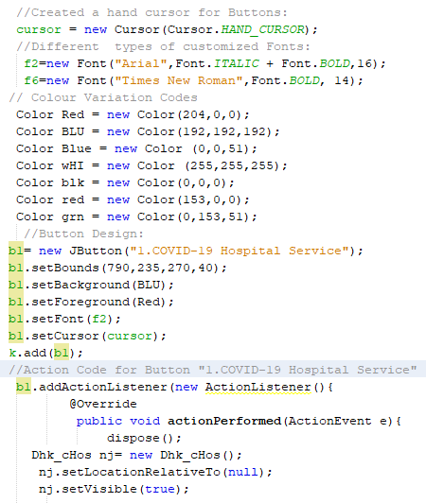
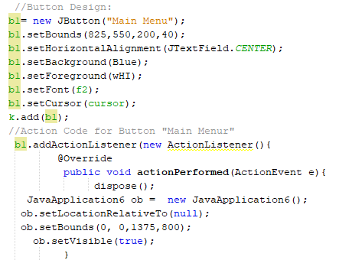
Font , Cursor, Color & Button Code:
Some Code Section of
District Info Page:
Main Menu button design and Action performer Code:

Slide 12

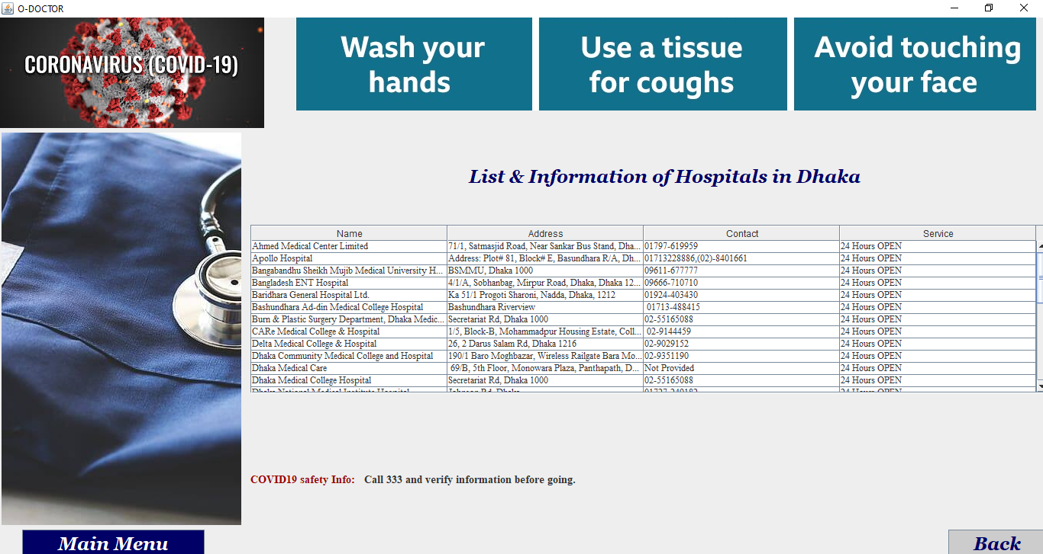
List & Info of General Hospitals
Project Output (Dhaka)
Data Table which has Hospital Information.
IEDCR helpline
Each Table contains 4 sections:
Name.
Address.
Contact Number.
Service.
4. Contains a Main Menu button which will take user to the home page.
5. Contains a Back Button which will take the user to division menu page.

Slide 13
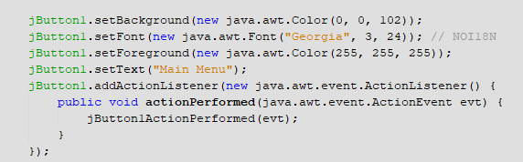
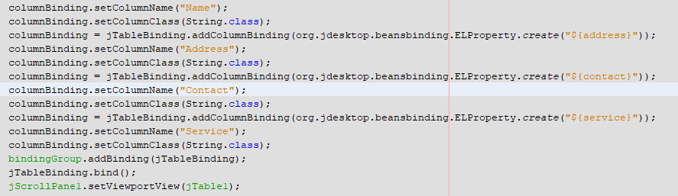
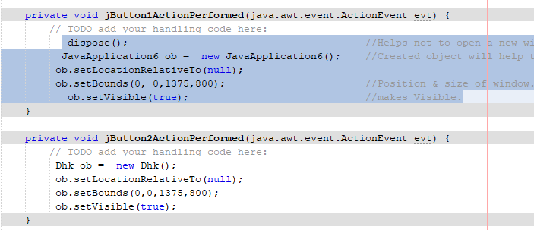
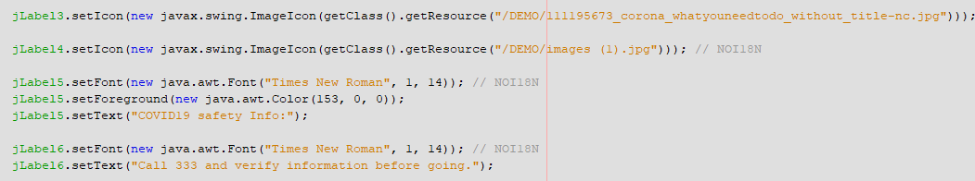
Some Code Samples of
General Hospitals Information Page:

Slide 14
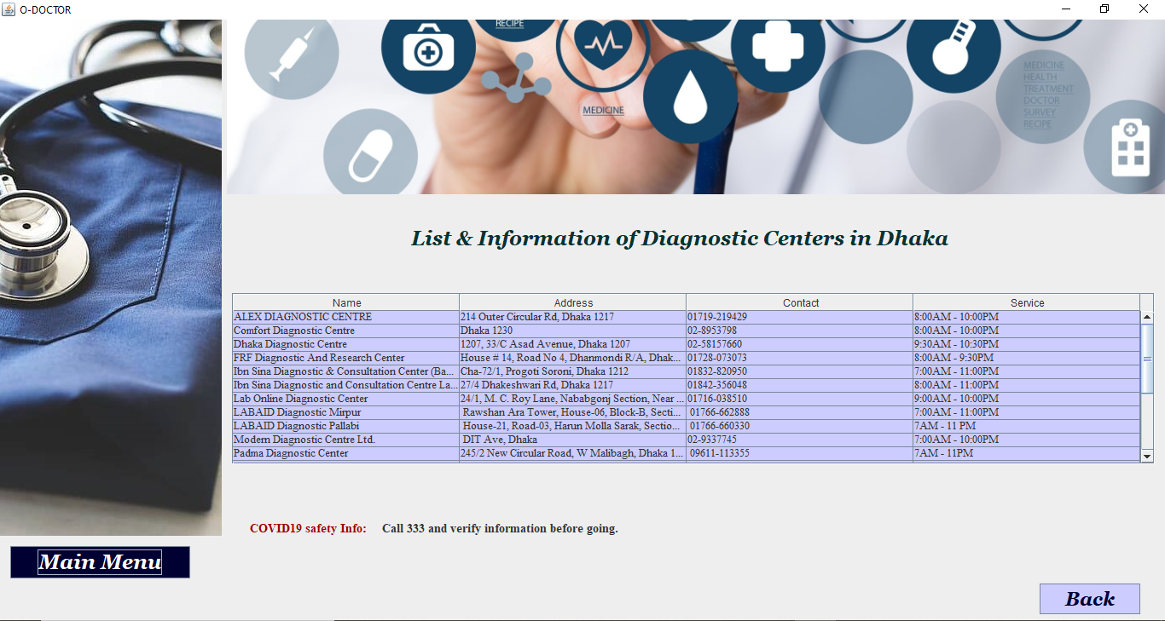
General Diagnostic Center list & Info
Data Table which has Diagnostic Centers Information.
IEDCR helpline
Each Table contains 4 sections:
Name
Address
Contact Number
Service Time.
4. Contains a Main Menu button which will take user to the home page.
5. Contains a Back Button which will take the user to division menu page.

Slide 15

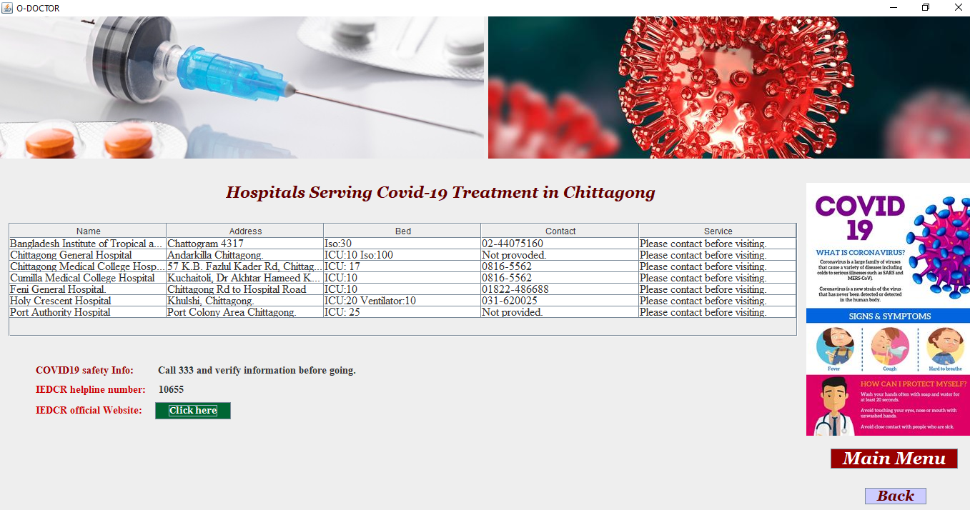
COVID-19 Hospital Service
Project Output
This page contains:
Data Table which has Hospital Information.
IEDCR helpline number.
IEDCR Official website links which will take user direct to the IEDCR website.
Will take the user Straight to the Main Menu(Home page).
Will take user back to the division information page.

Slide 16
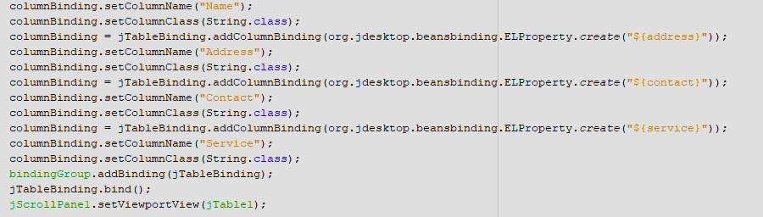
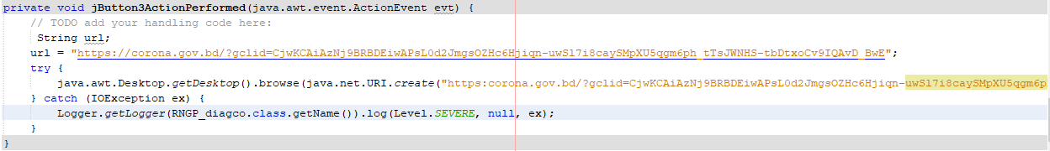
Database of Covid-19 Hospital (Dhaka):
Some Code Samples of
COVID-19 Hospital Page:
Code for Fetching data fromDatabase Table to Jtable:
Connecting website in JButton Action Performer:

Slide 17
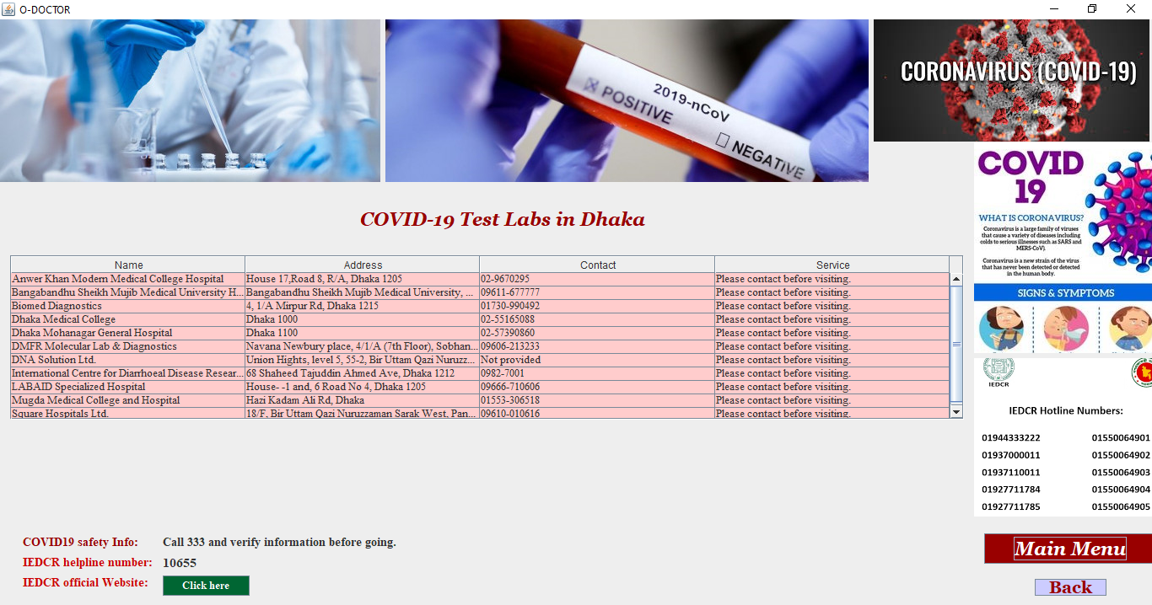
Covid-19 Test Labs
Project Output
This page contains:
Data Table which has Hospital Information.
IEDCR helpline number.
IEDCR Official website links which will take user direct to the IEDCR website.

Slide 18
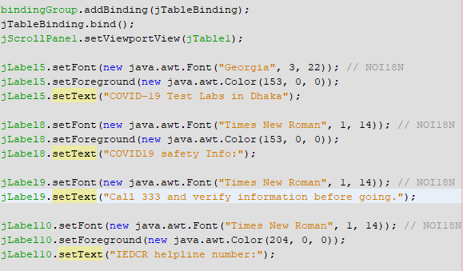
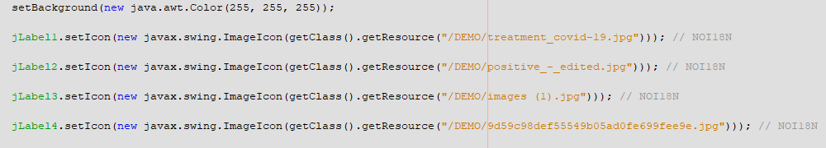
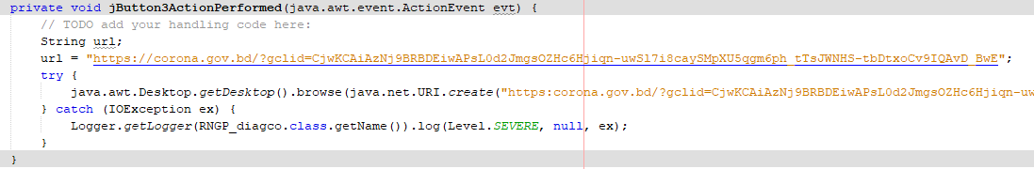
Some Code Samples of
COVID-19 Hospital Page:

Slide 19
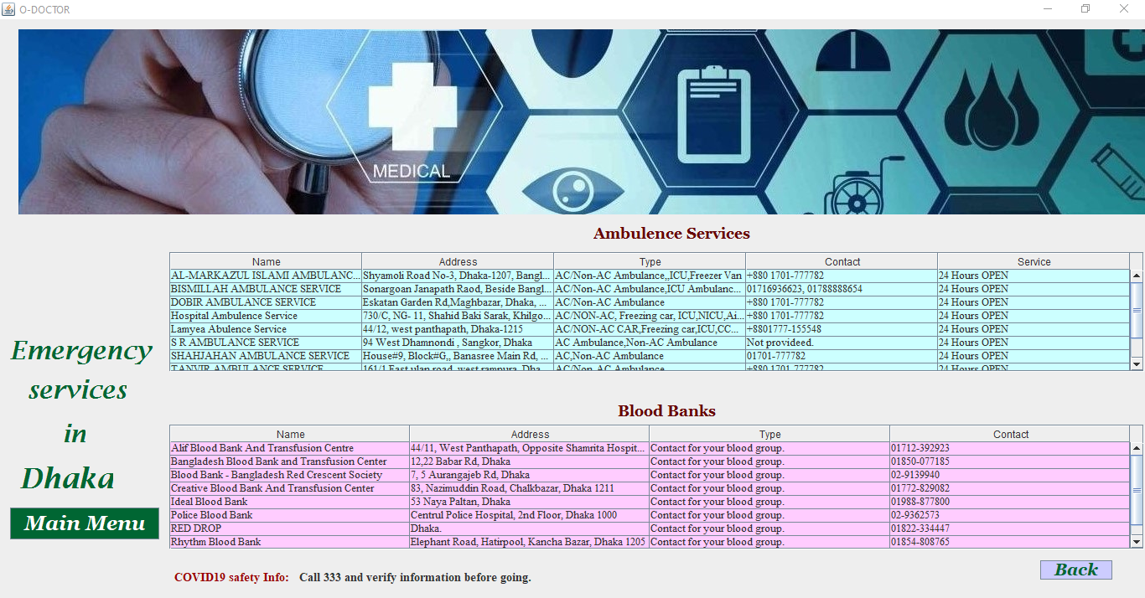
Emergency Services:
This section is divided into 2 parts. i) Ambulance Services ii)Blood Bank Services.
Section under these services:
Ambulance Services.
Name
We try ensure all medical services in one click.
Address.
Type of Ambulance
Contact Number.
Service Time.
Blood Bank
Name.
/FACEBOOK
Address.
www.hompageurl.com
Type of Blood Groups.
@TWITTER
Example Text Example Text Example Text Example Text Example Text
Contact Number.

Slide 20
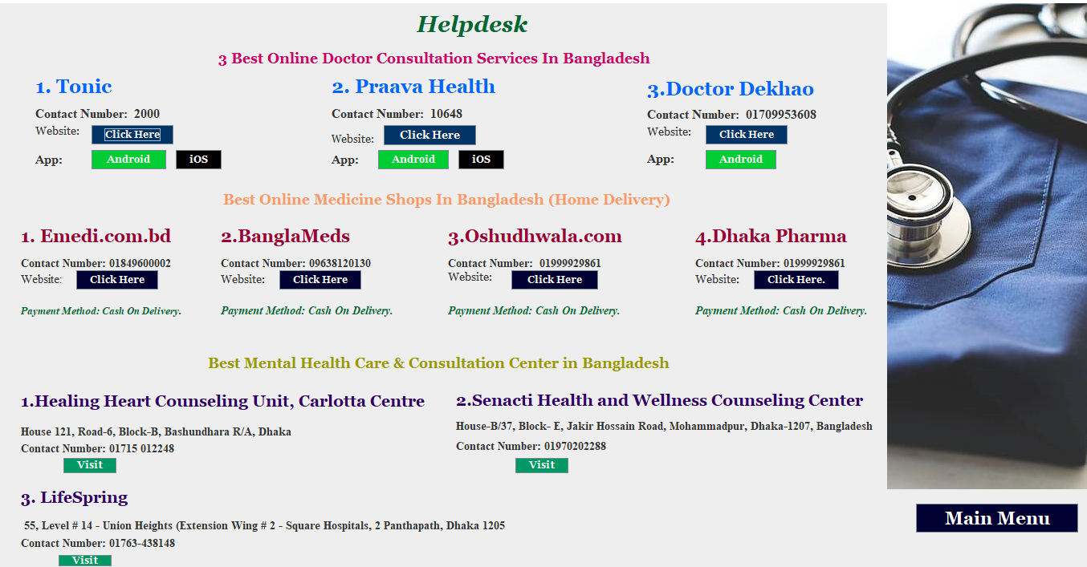
Helpdesk
Online Doctor Consultation Contact Information & Websites.
Online Pharmacy Service & Information.
Mental Health Consultation Center & their Information.
Will straightly take you to PlayStore to download the Android version if you’re an Android user you can easily get the service.
Will straightly take you to the iOS download version if you’re an iOS user you can easily get the service.
Takes directly to the Website of the Company or Organization.

Slide 21
Benefits
It will decrease the rate of getting infected by COVID-19 and ensure health safety of
1.COVID-19 Patients.
2.Non-COVID Patients.
3.Doctors and Health workers.
4.Emergency Patients.
Provide every kind of medical information.
Can easily get the resource of rare Medicines from the best online Pharmacies of Bangladesh who sells all kind of medicines in cash on delivery system.
People can consult with the best doctors of Bangladesh through the telemedicine Websites or Apps whose Contact info and Website links are also provided here.
Mental health soundness is very important in our day to day life. So if any user wants they can take appointments or directly consult with the doctors or Psychiatrists of top mental health agencies or organizations.
Project URL:

